Slide 1

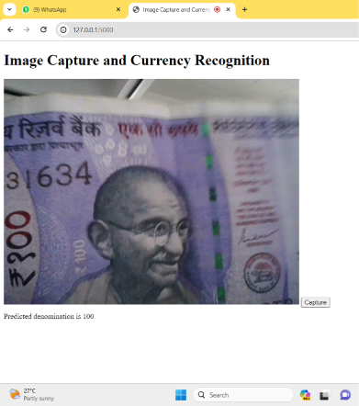


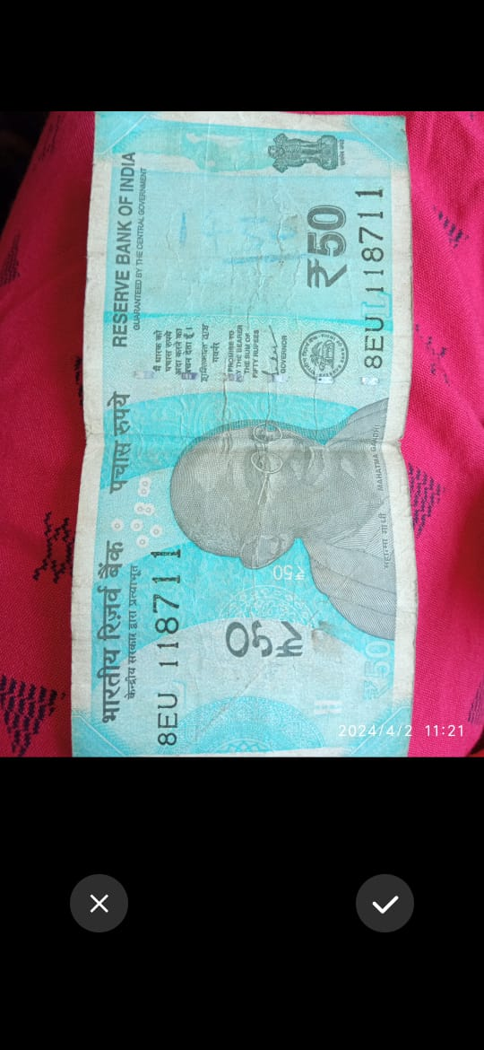
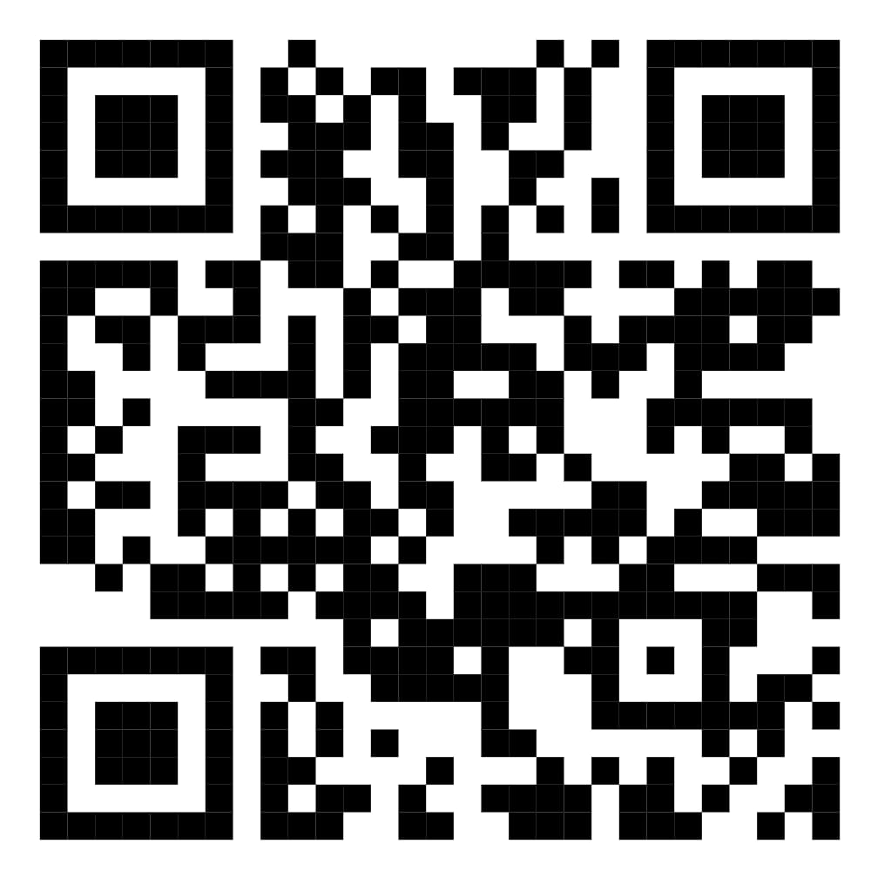
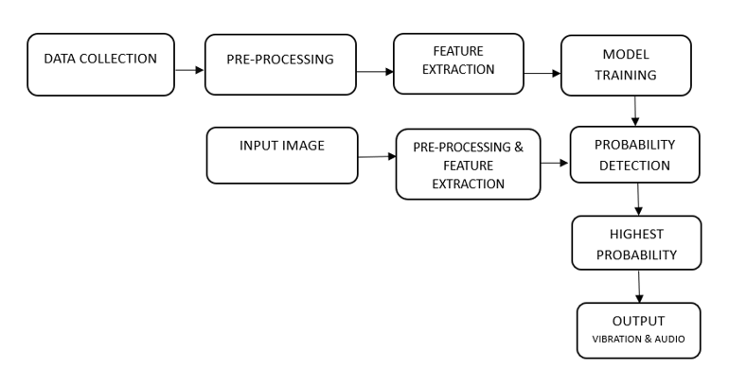
PAPER CURRENCY RECOGNITION FOR BLIND PEOPLE
TEAM MEMBERS: Dhivya R – 20BIT010, Doretta Marin A – 20BIT012, Yogasri Y – 20BIT063
GUIDE NAME : Ms. Sathyavathi S - Assistant Professor(SRG)
ABSTRACT
BACKGROUND OF THE STUDY
RESULTS
DISCUSSION
Blind individuals encounter obstacles recognizing paper currency, impeding financial independence. Traditional methods, like seeking help or folding, compromise privacy and autonomy. Our project addresses this challenge by developing a bespoke currency recognition system, empowering the visually impaired to autonomously manage finances. Through advanced image processing and machine learning, it enhances financial independence and daily interactions, fostering inclusivity and an improved quality of life.
The "Paper Currency Recognition for Blind People" project leverages AI and image processing to assist visually impaired individuals in identifying currency denominations, fostering financial independence and supporting their daily activities. The app developed under this project enables users to capture images of currency notes, receiving output in both voice and vibration formats. This dual output mechanism ensures that users can not only hear but also feel the information, enhancing accessibility and usability. By providing multi-modal feedback, the app empowers blind individuals to confidently manage their finances and meet their daily needs.
Text to Speech Conversion: Text labels are converted into human-like audio using gTTS, enhancing accessibility for visually impaired users through auditory feedback.
Mapping to Vibration: The system utilizes haptic feedback, mapping currency recognition results to distinguishable vibration patterns, enhancing accessibility for visually impaired users beyond visual and auditory cues.
Web Integration: A web app with camera access for currency recognition, providing voice and text output for visually impaired users, fostering accessibility and inclusivity.
App Integration: Our app, integrated with Google Assistant, allows voice-controlled image capture and provides audible and vibration feedback for visually impaired users, enabling independent currency identification.
VGG16 was selected for its proven effectiveness, despite longer training and higher memory usage. Integrating Android and web platforms broadens accessibility but poses optimization challenges. Training for 5 epochs balanced performance with computational constraints. Achieving 93% accuracy is commendable; refining architecture and augmenting data could boost it further. Incorporating voice and vibration feedback enhances usability, validated through user testing for efficacy and improvement insights.
OUTCOME
The model developed in this paper facilitates Indian paper currency recognition via a mobile application. Providing output through audio and vibrations, it aids the blind in independent financial transactions, reducing reliance on others. Deployed as a user-friendly mobile app, it integrates with voice recognition platforms like Google Assistant and Siri, allowing easy accessibility. By capturing images through simple voice commands, such as "cheese" or "capture," it empowers both visually and hearing-impaired individuals to identify currency in crowded or noisy environments like supermarkets and festivals, enhancing their autonomy in daily transactions.
PROCESS/METHODOLOGY
SPOTLIGHT OF THE PROJECT
Deploying a VGG algorithm, our currency recognition system trains by discerning patterns and Braille lines on banknotes. This intricate model harmonizes visual and tactile elements, producing an output symphony that transcends traditional boundaries. Its dual delivery through audio and vibration ensures a comprehensive and accessible experience, catering to diverse user needs and enhancing usability.
This app allows users to capture images using voice commands. The captured image is processed and the result is converted into text format for display. Additionally, the output is also converted into audio, providing an alternative way for users to perceive the information audibly.
Furthermore, the app incorporates vibration feedback, with each denomination of currency represented by a distinct number of vibrations. This feature helps users differentiate between different denominations based on the vibration count, enhancing accessibility for individuals with visual impairments or those who prefer tactile feedback.
QR LINK OF PROJECT VIDEO

